Slide 1


CSE 3711
-Computer Networks “Transport Layer”-
Prof. Dr. A.K.M. Muzahidul Islam
Computer Science & Engineering (CSE)
United International University (UIU)
Summer 2023
Notes:
Introduction:
TCP/IP and OSI Reference Models,
Internet Protocol Stack,
Circuit Switching vs. Packet Switching,
FDMA, TDMA
Physical Media,
Encoding and Decoding,
Delay and Packet Loss.

Slide 2
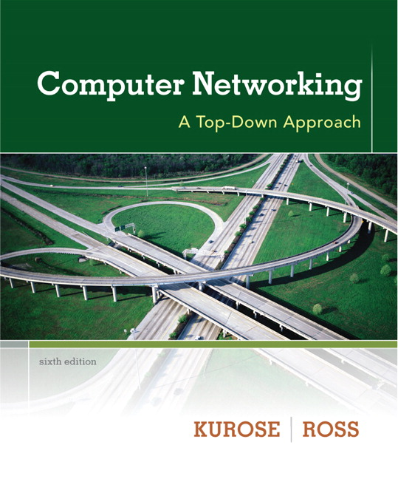
Chapter 3
Transport Layer
(Sec – 3.1, 3.2, 3.3, 3.4, 3.5 & 3.7)
Notes derived from “Computer Networking: A Top Down Approach”, Jim Kurose, Keith Ross, Addison-Wesley.
Slides are adapted from the companion web site of the book, as modified
by Prof. Dr. A.K.M. Muzahidul Islam.
Computer Networking: A Top Down Approach
7th edition
Jim Kurose, Keith Ross
Addison-Wesley
March 2017

Slide 3
Transport layer: overview
Our goal:
understand principles behind transport layer services:
  multiplexing, demultiplexing
  reliable data transfer
  flow control
  congestion control
learn about Internet transport layer protocols:
  UDP: connectionless transport
  TCP: connection-oriented reliable transport
  TCP congestion control

Slide 4









3.1 Transport services and protocols
application
transport
network
data link
physical
Transport Layer Protocols provide logical communication between application processes running on different hosts
Transport Layer Protocols are implemented in the End Systems, NOT in Network Routers
Transport protocols actions in end systems:
  Sender: breaks application messages into segments, passes to network layer
  Receiver: reassembles segments into messages, passes to application layer
mobile network
national or global ISP
logical end-end transport
local or regional ISP
home network
content
provider
network
application
transport
network
data link
physical
datacenter
network
Two transport protocols available to Internet applications
  TCP, UDP
  Each of them provides a different set of Transport-Layer Services to the Application
enterprise
network
Notes:
By logical communication , we
mean that from an application’s perspective, it is as if the hosts running the processes
were directly connected; in reality, the hosts may be on opposite sides of the
planet, connected via numerous routers and a wide range of link types. Application
processes use the logical communication provided by the transport layer to send
messages to each other, free from the worry of the details of the physical infrastructure
used to carry these messages.
Let’s look at each of these three (logical communications, actions,

Slide 5
Transport vs. network layer services and protocols
Transport Layer Protocol: Provides Logical Communication between processes running on different hosts
  relies on, enhances, network layer services
Network Layer Protocol: Provides Logical communication between hosts
household analogy:
12 kids in Ann’s house sending letters to 12 kids in Bill’s house:
hosts = houses
processes = kids
app messages = letters in envelopes
transport protocol = Ann and Bill who demux to in-house siblings
network-layer protocol = postal service

Slide 6
Transport Layer in the Internet
Internet makes 02 distinct Transport-Layer protocols available to the application layer:
  UDP – User Datagram Protocol
    Provides an Unreliable, Connectionless Services to the Invoking Application
  TCP – Transmission Control Protocol
    Provides a Reliable, Connection-oriented Services to the Invoking Application
When designing a Network Application, the application developer selects between UDP and TCP.
Transport Layer Packet for TCP is referred as a Segment.
Transport Layer Packet for UDP is referred as a Datagram.
Network Layer Protocol has a name – IP: Internet Protocol, which provides Logical Communication between hosts.
Every host has at least one IP address.
IP Service Model is a best-effort delivery service
  Makes its best effort to deliver segments between hosts
  However, makes No Guarantees, thus called as Unreliable Service

Slide 7
Two principal Internet transport protocols
application
transport
network
data link
physical
TCP: Transmission Control Protocol
  reliable, in-order delivery
  congestion control
  flow control
  connection setup
UDP: User Datagram Protocol
  unreliable, unordered delivery
  no-frills extension of “best-effort” IP
    it is known as best-effort IP due to its error handling capacity.
services not available:
  delay guarantees
  bandwidth guarantees
mobile network
national or global ISP
logical end-end transport
local or regional ISP
home network
content
provider
network
application
transport
network
data link
physical
datacenter
network
enterprise
network
Notes:
no-frills extension of “best-effort” IP :
UDP is also called NULL protocol as it is not connection-oriented. It is only used when speed is more important than reliability. As there is no overhead by transport layer except that it only provides error control as it has a checksum in its header. So, it reduces the error probability of IP datagram. So, it is known as best-effort IP due to its error handling capacity.

Slide 8
Transport Layer Actions
Sender:
application
application
is passed an application-layer message
app. msg
determines segment header fields values
T_{h}
transport
app. msg
transport
T_{h}
network (IP)
creates segment
network (IP)
link
passes segment to IP
link
physical
physical

Slide 9
Transport Layer Actions
Receiver:
application
receives segment from IP
application
checks header values
transport
transport
app. msg
extracts application-layer message
network (IP)
demultiplexes message up to application via socket
network (IP)
link
link
physical
physical
app. msg
T_{h}

Slide 10


3.2 Multiplexing/demultiplexing
demultiplexing at receiver:
multiplexing at sender:
use header info to deliver
received segments to correct
socket
handle data from multiple
sockets, add transport header (later used for demultiplexing)
application
application
P1
P2
application
socket
P3
transport
P4
process
transport
network
transport
network
link
network
link
physical
link
physical
physical
Multiplexing : The job of gathering data chunks at the source host from different sockets, encapsulating each data chunk with header information to create segments and passing the segments to the network layer.
Demultiplexing : The job of delivering the data in a transport-layer segment to the correct socket.

Slide 11
How demultiplexing works
host receives IP datagrams
  each datagram has source IP address, destination IP address
  each datagram carries one transport-layer segment
  each segment has source, destination port number
host uses IP addresses & port numbers to direct segment to appropriate socket
32 bits
source port #
dest port #
other header fields
application
data
(payload)
TCP/UDP segment format

Slide 12
3.3 UDP: User Datagram Protocol
Why is there a UDP?
“no frills i.e. no extra or unnecessary details,” “bare bones” Internet transport protocol
“best effort” service, UDP segments may be:
  lost
  delivered out-of-order to app
no connection establishment (which can add RTT delay)
simple: no connection state at sender, receiver
small header size
no congestion control
  UDP can blast away as fast as desired!
  can function in the face of congestion
connectionless:
  no handshaking between UDP sender, receiver
  each UDP segment handled independently of others

Slide 13
UDP: User Datagram Protocol
Aside from Multiplexing/Demultiplexing functions and Some Light Error Checking, it adds nothing to IP.
  i.e. the application is almost directly talking with IP
UDP takes messages from the application process, attaches Source and Destination Port Number Fields, adds two other small fields and passes the segment to the Network Layer.
UDP use:
  streaming multimedia apps (loss tolerant, rate sensitive)
  DNS
  SNMP – Simple Network Management Protocol
  HTTP/3 – More recent version of HTTP
if reliable transfer needed over UDP (e.g., HTTP/3):
  add needed reliability at application layer
  add congestion control at application layer

Slide 14
UDP: Transport Layer Actions
SNMP client
SNMP server
application
application
transport
(UDP)
transport
(UDP)
network (IP)
network (IP)
link
link
physical
physical

Slide 15
UDP: Transport Layer Actions
SNMP client
SNMP server
UDP sender actions:
application
application
is passed an application-layer message
SNMP msg
transport
(UDP)
determines UDP segment header fields values
transport
(UDP)
UDP_{h}
SNMP msg
UDP_{h}
network (IP)
creates UDP segment
network (IP)
link
passes segment to IP
link
physical
physical

Slide 16
UDP: Transport Layer Actions
SNMP client
SNMP server
UDP receiver actions:
application
receives segment from IP
application
checks UDP checksum header value
transport
(UDP)
transport
(UDP)
SNMP msg
extracts application-layer message
network (IP)
network (IP)
SNMP msg
UDP_{h}
demultiplexes message up to application via socket
link
link
physical
physical

Slide 17
UDP segment header
32 bits
source port #
dest port #
length
checksum
application
data
(payload)
length, in bytes of UDP segment, including header
data to/from application layer
UDP segment format
Application Data : Occupies the data field of the UDP segment.
Length Field : No. of bytes in UDP segment i.e. Header + Data.
Checksum : Used by the receiving host to check whether errors have been introduced into the segment.

Slide 18
Exercise: Spring 2023
Suppose that a process running with port 61 is using a UDP segment is to send the following 2 bits to another process with port 53.
01011010 01110001
Now answer the following questions:
    What will be length (in bytes) of the UDP segment that will be sent from the transport layer? [ 1.5 ]
    What fields are contained in the headers of a UDP segment? How big are each of these fields? [ 1.5 ]
    Calculate the checksum for the UDP segment. The checksum of a UDP segment is 2 bytes long (having values between 0 and 65535), and it is calculated over the entire UDP segment, including the UDP headers and the data payload. [ 1.5 ]
What will be the values of each of the fields of the header of the UDP segment that is being sent in the given scenario? [ 1.5 ]

Slide 19
Checksum
Transmitting Side
1100
0010
+ 1100
1000
---------------
0010 0010
Receiving Side
  0010 0010
  + 1011 (Checksum)
  ----------------------
  0010 1101
0010
0010
------
0100
Flip -> 1011 (Checksum)
0010
1101
------
1111
Flip -> 0000 (Correct)

Slide 20
CRC Example
Send
  M(x) = 110011 → x⁵+x⁴+x+1 (6 bits)
  P(x) = 11001 → x⁴+x³+1 (5 bits, n = 4)
  → 4 bits of redundancy
  Form x^{n}M(x) → 110011 0000
  → x⁹+x⁸+x⁵+x⁴
  Divide x^{n}M(x) by P(x) to find C(x)
Receive
No remainder
→ Accept
= C(x)
Send the block 110011 1001

Slide 21


Slide 22

3.4 Principles of reliable data transfer
sending process
receiving process
application
data
data
transport
reliable channel
reliable service abstraction
The Figure illustrates the framework of reliable data transfer.
The service abstraction provided to the upper-layer entities is that of a reliable channel through which data can be transferred.
  With a reliable channel,
    no transferred data bits are corrupted or lost, and
    all data are delivered in the order in which they were sent.
This is precisely the service model offered by TCP to the Internet applications that invoke it.
Notes:
note arrows through reliable data transfer channel is just one way – reliably send from sender to receiver

Slide 23

Principles of reliable data transfer
sending process
receiving process
sending process
receiving process
application
data
data
application
data
data
transport
reliable channel
transport
reliable service abstraction
sender-side of
reliable data transfer protocol
receiver-side
of reliable data transfer protocol
transport
network
unreliable channel
reliable service implementation
It is the responsibility of a reliable data transfer protocol to implement this service abstraction.
The task is made difficult by the fact that the layer below the reliable data transfer protocol may be unreliable.
  For example, TCP is a reliable data transfer protocol that is implemented on top of an unreliable (IP) end-to-end network layer.
Notes:
Spend some time talking about how its to the sender and receiver side protocol that IMPLEMENTS reliable data transfer
Communication over unreliable channel is TWO-way: sender and receiver will exchange messages back and forth to IMPLEMENT one-way reliable data transfer

Slide 24
Principles of reliable data transfer
sending process
receiving process
application
data
data
transport
sender-side of
reliable data transfer protocol
receiver-side
of reliable data transfer protocol
However,
The Complexity of reliable data transfer protocol will depend (strongly) on characteristics of unreliable channel (lose, corrupt, reorder data?)
transport
network
unreliable channel
reliable service implementation
Notes:
So we have a sender side and a receiver side. How much work they’ll have to do depends on the IMPAIRMENTS introduced by channel – if the channel is perfect – no problem!

Slide 25

Principles of reliable data transfer
sending process
receiving process
application
data
data
transport
sender-side of
reliable data transfer protocol
receiver-side
of reliable data transfer protocol
Sender, receiver do not know the “state” of each other, e.g., was a message received?
unless communicated via a message
transport
network
unreliable channel
reliable service implementation
Notes:
Here’s a point of view to keep in mind – it’s easy for US to look at sender and receiver together and see what is happening. OH – that message sent was lost.
But think about it say from senders POV How does the sender know if its transmitted message over the unreliable channel got though?? ONLY if receiver somehow signals to the sender that it was received.
The key point here is that one side does NOT know what is going on at the other side – it’s as if there’s a curtain between them. Everything they know about the other can ONLY be learned by sending/receiving messages.
Sender process wants to make sure a segment got through. But it can just somehow magically look through curtain to see if receiver got it. It will be up to the receiver to let the sender KNOW that it (the receiver) has correctly received the segment.
How will the sender and receiver do that – that’s the PROTOCOL.
Before starting to develop a protocol, let’s look more closely at the interface (the API if you will)

Slide 26
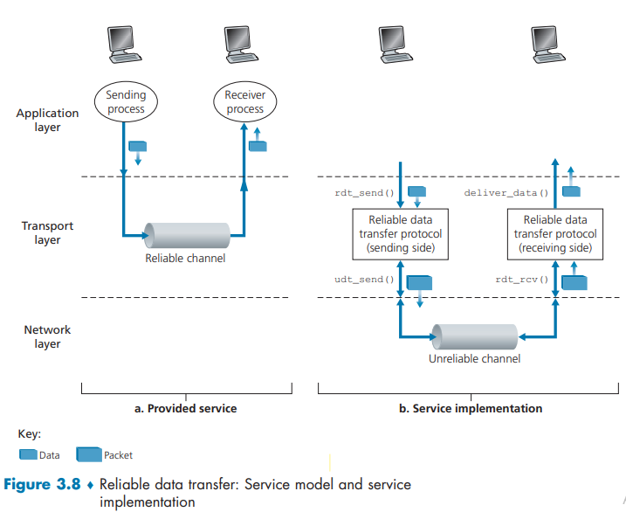
Reliable data transfer protocol (rdt)
We incrementally develop the sender and receiver sides of a reliable data transfer protocol, considering increasingly complex models of the underlying channel.
For example, what protocol mechanisms are needed when the underlying channel can corrupt bits or lose entire packets.
One assumption is that packets will be delivered in the order in which they were sent, with some packets possibly being lost; that is, the underlying channel will not reorder packets.

Slide 27
Reliable data transfer protocol (rdt): interfaces
Sending Side
Receiving Side
1. rdt_send(): called from above, (e.g., by app.).
Passed data to deliver to receiver upper layer
4. deliver_data(): called by rdt to deliver data to upper layer
sending process
receiving process
rdt_send()
data
data
Both the send and receive sides of rdt send packets to the other side by a call to udt_send()
deliver_data()
data
sender-side
implementation of rdt reliable data transfer protocol
receiver-side
implementation of rdt reliable data transfer protocol
packet
udt_send()
Header
data
Header
data
rdt_rcv()
unreliable channel
2. udt_send(): called by rdt
to transfer packet over
unreliable channel to receiver
3. rdt_rcv(): called when packet arrives on receiver side of channel
Bi-directional communication over unreliable channel
Figure indicates only Unidirectional i.e. data transfer from the sending to the receiving side.
Bi-directional : data transfer from both sending and receiving sides.

Slide 28
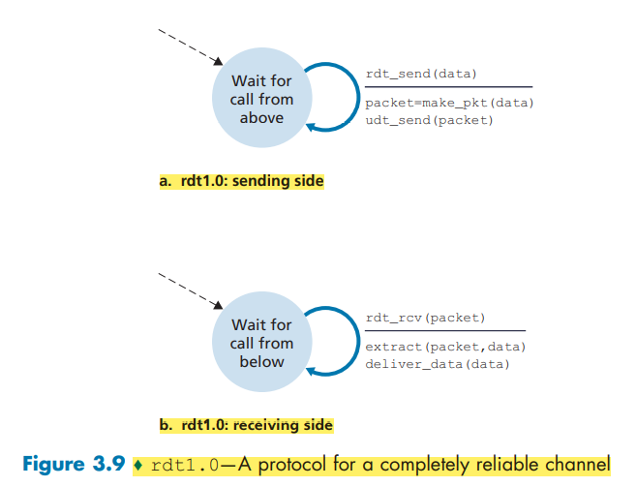
Reliable Data Transfer over a Perfectly Reliable Channel: rdt1.0
Case 1 - where the underlying channel is completely reliable.
The finite-state machine (FSM) definitions for the rdt1.0 sender and receiver are shown in Figure 3.9.
The FSM in Figure 3.9(a) defines the operation of the sender, while the FSM in Figure 3.9(b) defines the operation of the receiver
The sending side of rdt
simply accepts data from the upper layer via the rdt_send(data) event,
creates a packet containing the data (via the action make_pkt(data)) and
sends the packet into the channel.
In practice, the rdt_send(data) event would result from a procedure call (for example, to rdt_send()) by the upper-layer application.

Slide 29
Reliable Data Transfer over a Perfectly Reliable Channel: rdt1.0
On the receiving side,
rdt receives a packet from the underlying channel via the rdt_rcv(packet) event,
Removes the data from the packet (via the action extract (packet, data)) and
passes the data up to the upper layer (via the action deliver_data(data)).
In practice, the rdt_rcv(packet) event would result from a procedure call (for example, to rdt_rcv()) from the lowerlayer protocol.

Slide 30
Reliable Data Transfer over a Channel with Bit Errors: rdt2.0
A more realistic model of the underlying channel is one in which bits in a packet may be corrupted.
Such bit errors typically occur in the physical components of a network as a packet is transmitted, propagates, or is buffered.
The message-dictation protocol uses both
  positive acknowledgments (“OK”)
  negative acknowledgments (“Please repeat that.”)
In a computer network setting, reliable data transfer protocols based on such retransmission are known as ARQ (Automatic Repeat reQuest) protocols.
03 additional protocol capabilities are required in ARQ protocols to handle the presence of bit errors:
  Error Detection
    UDP uses Internet Checksum field
  Receiver Feedback
    The positive (ACK) and
    Negative (NAK) acknowledgment replies
  Retransmission

Slide 31
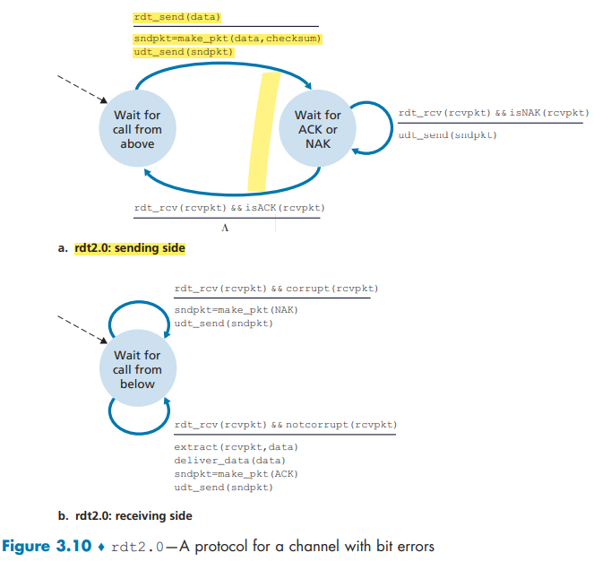
Figure 3.10 shows the FSM representation of rdt2.0, a data transfer protocol employing error detection, positive acknowledgments, and negative acknowledgments.

Slide 32
stop-and-wait operation (Non-pipelined)
sender
receiver
first packet bit transmitted, t = 0
first packet bit arrives
Round-trip time (RTT)
last packet bit arrives, send ACK
ACK arrives, send next
packet, t = RTT + L / R
The sender will not send a new piece of data until it is sure that the receiver has correctly received the current packet.
Because of this behavior, protocols such as rdt2.0 are known as stop-and-wait protocols.
When the sender is in the wait-for-ACK-or-NAK state, it cannot get more data from the upper layer; that is, the rdt_send() event occurs after the sender receives an ACK.
Sender send a new piece of data iff receiver has correctly received the current packet. Thus, rdt2.0 is known as stop-and-wait protocols.

Slide 33

Reliability in action (Stop-and-Wait)
The sender does not know whether a data packet was lost, an ACK was lost, or if the packet or ACK was simply overly delayed.
  In all cases, the action is the same: retransmit.
Time-based retransmission mechanism requires a countdown timer.
  The sender will need to (1) start the timer each time a packet is sent
  (2) respond to a timer interrupt
  (3) stop the timer.
sender
receiver
sender
receiver
send pkt0
pkt0
send pkt0
pkt0
rcv pkt0
rcv pkt0
ack0
send ack0
ack0
send ack0
rcv ack0
rcv ack0
send pkt1
pkt1
send pkt1
pkt1
rcv pkt1
X
ack1
send ack1
loss
rcv ack1
send pkt0
pkt0
rcv pkt0
timeout
resend pkt1
pkt1
ack0
send ack0
rcv pkt1
ack1
send ack1
rcv ack1
send pkt0
pkt0
(a) no loss
rcv pkt0
ack0
send ack0
(b) packet loss
Figure 3.16 Operation of rdt3.0, the alternating-bit protocol

Slide 34
Reliability in action (Stop-and-Wait)
Because packet sequence numbers alternate between 0 and 1, protocol rdt3.0 is sometimes known as the alternating-bit protocol.
sender
receiver
sender
receiver
send pkt0
pkt0
rcv pkt0
send pkt0
pkt0
send ack0
rcv pkt0
rcv ack0
ack0
ack0
send ack0
send pkt1
pkt1
rcv ack0
rcv pkt1
send pkt1
pkt1
send ack1
ack1
rcv pkt1
ack1
X
send ack1
loss
timeout
resend pkt1
timeout
resend pkt1
pkt1
rcv pkt1
pkt1
rcv pkt1
rcv ack1
(detect duplicate)
send pkt0
pkt0
send ack1
ack1
(detect duplicate)
rcv pkt0
rcv ack1
send ack1
rcv ack1
ack1
send pkt0
pkt0
(ignore)
ack0
send ack0
rcv pkt0
ack0
send ack0
pkt1
(c) ACK loss
(d) premature timeout/ delayed ACK
Figure 3.16 Operation of rdt3.0, the alternating-bit protocol

Slide 35
The performance impact of this stop-and-wait behavior
Consider an idealized case of two hosts, one located on the West Coast of the United States and the other located on the East Coast. The speed-of-light round-trip propagation delay between these two end systems, RTT, is approximately 30 milliseconds.
Suppose that they are connected by a channel with a transmission rate, R, of 1 Gbps (109 bits per second).
With a packet size, L, of 1,000 bytes (8,000 bits) per packet, including both header fields and data, the time needed to actually transmit the packet into the 1 Gbps link is
dtrans = L/R = 8000 bits 10 pow 9 bits/sec = 8 microseconds
Figure 3.18(a) shows that with our stop-and-wait protocol, if the sender begins sending the packet at t = 0, then at t = L/R = 8 microseconds, the last bit enters the channel at the sender side.
The packet then makes its 15-msec cross-country journey, with the last bit of the packet emerging at the receiver at t = RTT/2 + L/R = 15.008 msec.

Slide 36
Assuming ACK packets are extremely small (so that we can ignore their transmission time) and that the receiver can send an ACK as soon as the last bit of a data packet is received,
  the ACK emerges back at the sender at t = RTT + L/R = 30.008 msec.
  At this point, the sender can now transmit the next message.
  Thus, in 30.008 msec, the sender was sending for only 0.008 msec.
If we define the utilization of the sender (or the channel) as the fraction of time the sender is actually busy sending bits into the channel, the analysis in Figure 3.18(a) shows that
  the stop-and-wait protocol has a rather dismal sender utilization, Usender, of
  Usender = L/R / (RTT + L/R) = .008 / 30.008 = 0.00027
  That is, the sender was busy only 2.7 hundredths of one percent of the time!
  Viewed another way, the sender was able to send only 1,000 bytes in 30.008 milliseconds.

Slide 37


Pipelined protocols operation
pipelining: sender allows multiple, “in-flight”, yet-to-be-acknowledged packets
  range of sequence numbers must be increased
  buffering at sender and/or receiver

Slide 38
Pipelining: increased utilization
sender
receiver
first packet bit transmitted, t = 0
last bit transmitted, t = L / R
first packet bit arrives
RTT
last packet bit arrives, send ACK
last bit of 2nd packet arrives, send ACK
last bit of 3rd packet arrives, send ACK
ACK arrives, send next
packet, t = RTT + L / R
3-packet pipelining increases
utilization by a factor of 3!
If the sender is allowed to transmit 03 packets before having to wait for acknowledgments, the utilization of the sender is essentially tripled.
Since the many in-transit sender-to-receiver packets can be visualized as filling a pipeline, this technique is known as pipelining.
Notes:
two generic forms of pipelined protocols: go-Back-N, selective repeat

Slide 39
Go-Back-N in action – Pipeline Protocol
In a Go-Back-N (GBN) protocol, the sender is allowed to transmit multiple packets (when available) without waiting for an acknowledgment, but is constrained to have no more than some maximum allowable number, N, of unacknowledged packets in the pipeline.
sender window (N=4)
sender
receiver
0 1 2 3 4 5 6 7 8
send pkt0
send pkt1
send pkt2
send pkt3
(wait)
0 1 2 3 4 5 6 7 8
receive pkt0, send ack0
receive pkt1, send ack1
receive pkt3, discard,
(re)send ack1
0 1 2 3 4 5 6 7 8
X
0 1 2 3 4 5 6 7 8
loss
0 1 2 3 4 5 6 7 8
rcv ack0, send pkt4
0 1 2 3 4 5 6 7 8
rcv ack1, send pkt5
receive pkt4, discard,
(re)send ack1
ignore duplicate ACK
receive pkt5, discard,
(re)send ack1
pkt 2 timeout
0 1 2 3 4 5 6 7 8
send pkt2
send pkt3
send pkt4
send pkt5
0 1 2 3 4 5 6 7 8
rcv pkt2, deliver, send ack2
rcv pkt3, deliver, send ack3
rcv pkt4, deliver, send ack4
rcv pkt5, deliver, send ack5
0 1 2 3 4 5 6 7 8
0 1 2 3 4 5 6 7 8
Notes:
Let’s skip FSM specification for GBN – check out the book or ppt – and let’s watch GBN sender and receivers in action.
Let assume a window size of 4. at t=0, sender sends packets 0, 1, 2 3, 4, and packet 2 will be lost
At the receiver:
Packet 0 received ACK0 generated
Packet 1 received ACK1 generated
Packet 2 is lost, and so when packet 3 is received, ACK 1 is sent – that’s the cumulative ACK, re-Acknowledging the receipt of packet 1. and in this implementation packet 3 is discarded

Slide 40
Selective Repeat in action – Pipeline Protocol
When the window size and bandwidth-delay product are both large, many packets can be in the pipeline.
A single packet error can thus cause GBN to retransmit a large number of packets, many unnecessarily.
sender
sender window (N=4)
receiver
0 1 2 3 4 5 6 7 8
send pkt0
send pkt1
send pkt2
send pkt3
(wait)
0 1 2 3 4 5 6 7 8
receive pkt0, send ack0
receive pkt1, send ack1
receive pkt3, buffer,
send ack3
0 1 2 3 4 5 6 7 8
X
0 1 2 3 4 5 6 7 8
loss
0 1 2 3 4 5 6 7 8
rcv ack0, send pkt4
0 1 2 3 4 5 6 7 8
rcv ack1, send pkt5
receive pkt4, buffer,
send ack4
record ack3 arrived
receive pkt5, buffer,
send ack5
pkt 2 timeout
0 1 2 3 4 5 6 7 8
send pkt2
(but not 3,4,5)
0 1 2 3 4 5 6 7 8
0 1 2 3 4 5 6 7 8
rcv pkt2; deliver pkt2,
pkt3, pkt4, pkt5; send ack2
0 1 2 3 4 5 6 7 8
Q: what happens when ack2 arrives?

Slide 42
3.5 TCP: overview RFCs: 793,1122, 2018, 5681, 7323
TCP is connection-oriented because before one application process can begin to send data to another, the two processes must first “handshake” with each other.
Two processes must send some preliminary segments to each other to establish the parameters of the ensuing data transfer.
  For example, client first sends a special TCP segment; the server responds with a second special TCP segment; and finally the client responds again with a third special segment - Three-way Handshake.
As part of TCP connection establishment, both sides of the connection will initialize many TCP state variables associated with the TCP connection.
TCP protocol runs only in the end systems and not in the intermediate network elements (e.g., routers and link-layer switches).
The intermediate network elements do not maintain TCP connection state. The intermediate routers are completely oblivious to TCP connections; they see datagrams, not connections.
Notes:
Typical MSS is 1460 bytes
TCP is said to be connection-oriented because before one application process can begin to send data to another, the two processes must first “handshake” with each other—that is, they must send some preliminary segments to each other to establish the parameters of the ensuing data transfer. As part of TCP connection establishment, both sides of the connection will initialize many TCP state variables (many of which will be discussed in this section and in Section 3.7) associated with the TCP connection.

Slide 43
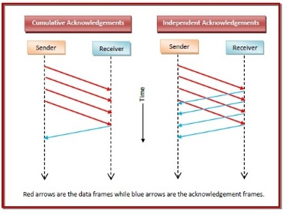
3.5 TCP: overview RFCs: 793,1122, 2018, 5681, 7323
point-to-point:
    one sender, one receiver
reliable, in-order byte steam:
    no “message boundaries"
full duplex data:
  Bi-directional data flow in same connection i.e. data can flow between Processes A and B.
  The maximum segment size (MSS) : The maximum amount of data that can be grabbed and placed in a segment is limited by maximum segment size,
    typically 1460 bytes.
cumulative ACKs
pipelining:
    TCP congestion and flow control set window size
connection-oriented:
  handshaking (exchange of control messages) initializes sender, receiver state before data exchange
flow controlled:
  TCP will ensure that a sender is not overwhelming a receiver by sending packets faster than it can consume
Notes:
Typical MSS is 1460 bytes
TCP is said to be connection-oriented because before one application process can begin to send data to another, the two processes must first “handshake” with each other—that is, they must send some preliminary segments to each other to establish the parameters of the ensuing data transfer. As part of TCP connection establishment, both sides of the connection will initialize many TCP state variables (many of which will be discussed in this section and in Section 3.7) associated with the TCP connection.

Slide 44
Multiplexing/demultiplexing
demultiplexing at receiver:
multiplexing at sender:
use header info to deliver
received segments to correct
socket
handle data from multiple
sockets, add transport header (later used for demultiplexing)
application
application
P1
P2
application
socket
P3
transport
P4
process
transport
network
transport
network
link
network
link
physical
link
physical
physical
Multiplexing : The job of gathering data chunks at the source host from different sockets, encapsulating each data chunk with header information to create segments and passing the segments to the network layer.
Demultiplexing : The job of delivering the data in a transport-layer segment to the correct socket.

Slide 45
TCP segment structure
Source and destination port numbers
  Used for multiplexing/ demultiplexing data from/to upper-layer applications.
The 32-bit sequence number field and the 32-bit acknowledgment number field
  Used by the TCP sender and receiver in implementing a reliable data transfer service.
32 bits
source port #
dest port #
segment seq #: counting bytes of data into bytestream (not segments!)
ACK: seq # of next expected byte; A bit: this is an ACK
sequence number
acknowledgement number
length (of TCP header)
head
len
not
used
A
receive window
flow control: # bytes receiver willing to accept
C
P
E
S
U
R
F
Internet checksum
checksum
Urg data pointer
C, E: congestion notification
options (variable length)
TCP options
Used when a sender and receiver negotiate the maximum segment size (MSS) or as a window scaling factor for use in high-speed networks.
application
data
(variable length)
data sent by application into TCP socket
RST, SYN, FIN: connection setup and tear down i.e. connection management

Slide 46
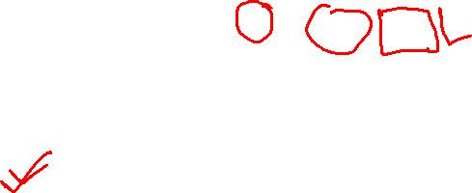
TCP sequence numbers, ACKs
These fields are a critical part of
TCP’s reliable data transfer service.
Sequence numbers:
  The sequence number for a segment is the byte stream “number” of first byte in segment’s data
Acknowledgements:
  The acknowledgment number that Host A puts in its segment is the sequence number of the next byte Host A is expecting from Host B.
  cumulative ACK
outgoing segment from sender
source port #
dest port #
sequence number
acknowledgement number
rwnd
checksum
urg pointer
window size
N
  sender sequence number space
sent
ACKed
sent, not-yet ACKed
(“in-flight”)
usable
but not
yet sent
not
usable
outgoing segment from receiver
source port #
dest port #
sequence number
acknowledgement number
A
rwnd
checksum
urg pointer
Q: how receiver handles out-of-order segments
  A: TCP spec doesn’t say, - up to implementor

Slide 47

TCP sequence numbers, ACKs
Suppose, Host A initiates a Telnet session with Host B.
Host A initiates the session - client, and Host B - server.
The starting sequence numbers are 42 and 79 for the client and server.
Host A
Host B
User types‘C’
Seq=42, ACK=79, data = ‘C’
host ACKs receipt of‘C’, echoes back ‘C’
Seq=79, ACK=43, data = ‘C’
host ACKs receipt of echoed ‘C’
  The acknowledgment number is the sequence number of the next byte.
Seq=43, ACK=80
simple telnet scenario
Notes:
The key thing to note here is that the ACK number (43) on the B-to-A segment is one more than the sequence number (42) on the A-toB segment that triggered that ACK
Similarly, the ACK number (80) on the last A-to-B segment is one more than the sequence number (79) on the B-to-A segment that triggered that ACK

Slide 48
TCP Sender (simplified)
There are 03 major events related to data transmission and retransmission in the TCP sender:
  data received from application above;
  timer timeout; and
  ACK receipt.
1. event: data received from application
TCP receives data from the application, encapsulates the data in a segment, and passes the segment to IP.
Create segment with seq #
seq # is byte-stream number of first data byte in segment
TCP starts the timer when the segment is passed to IP.
  think of timer as for oldest unACKed segment
  expiration interval: TimeOutInterval
2. event: timeout
TCP responds to the timeout event by retransmitting the segment that caused the timeout.
TCP restarts the timer
3. event: ACK received
The arrival of an acknowledgment segment (ACK) from the receiver.
if ACK acknowledges previously unACKed segments
  update what is known to be ACKed
  start timer if there are still unACKed segments
Notes:
Given these details of TCP sequence numbers, acks, and timers, we can now describe the big picture view of how the TCP sender and receiver operate
You can check out FSMs in book; let’s just give an English text description here and let’s start with the sender.

Slide 49


TCP: retransmission scenarios
Host A
Host B
Suppose that this segment has sequence number 92 and contains 8 bytes of data. After sending this segment, Host A waits for a segment from B with acknowledgment number 100.
Although the segment from A is received at B, the acknowledgment from B to A gets lost. In this case, the timeout event occurs, and Host A retransmits the same segment.
Seq=92, 8 bytes of data
timeout
ACK=100
X
Seq=92, 8 bytes of data
ACK=100
lost ACK scenario
Notes:
To cement our understanding of TCP reliability, let’s look a a few retransmission scenarios
In the first case a TCP segments is transmited and the ACK is lost, and the TCP timeout mechanism results in another copy of being transmitted and then re-ACKed a the sender
In the second example two segments are sent and acknowledged, but there is a premature timeout e for the first segment, which is retransmitted. Notet that when this retransmitted segment is received, the receiver has already received the first two segments, and so resends a cumulative ACK for both segments received so far, rather than an ACK for just this fist segment.

Slide 50

TCP: retransmission scenarios
Host A sends two segments back to back. The first segment has sequence number 92 and 8 bytes of data, and the second segment has sequence number 100 and 20 bytes of data.
Suppose that both segments arrive intact at B, and B sends two separate acknowledgments for each of these segments.
The first of these acknowledgments has acknowledgment number 100; the second has acknowledgment number 120.
Suppose now that neither of the acknowledgments arrives at Host A before the timeout.
  When the timeout event occurs, Host A resends the first segment with sequence number 92 and restarts the timer.
  As long as the ACK for the second segment arrives before the new timeout, the second segment will not be retransmitted.
Host A
Host B
SendBase=92
Seq=92, 8 bytes of data
timeout
Seq=100, 20 bytes of data
ACK=100
ACK=120
SendBase=100
Seq=92, 8
bytes of data
send cumulative
ACK for 120
SendBase=120
ACK=120
SendBase=120
premature timeout
Notes:
To cement our understanding of TCP reliability, let’s look a a few retransmission scenarios
In the first case a TCP segments is transmited and the ACK is lost, and the TCP timeout mechanism results in another copy of being transmitted and then re-ACKed a the sender
In the second example two segments are sent and acknowledged, but there is a premature timeout e for the first segment, which is retransmitted. Notet that when this retransmitted segment is received, the receiver has already received the first two segments, and so resends a cumulative ACK for both segments received so far, rather than an ACK for just this fist segment.

Slide 51

TCP: retransmission scenarios
Host A
Host B
In a third and final scenario, suppose Host A sends the two segments, exactly as in the second example.
The acknowledgment of the first segment is lost in the network, but just before the timeout event, Host A receives an acknowledgment with acknowledgment number 120.
  Host A therefore knows that Host B has received everything up through byte 119;
  So Host A does not resend either of the two segments.
Seq=92, 8 bytes of data
Seq=100, 20 bytes of data
X
ACK=100
ACK=120
Seq=120, 15 bytes of data
cumulative ACK covers for earlier lost ACK
Notes:
And in this last example, two segments are again transmitted, the first ACK is lost but the second ACK, a cumulative ACK arrives at the sender, which then can transmit a third segment, knowing that the first two have arrived, even though the ACK for the first segment was lost

Slide 52


TCP fast retransmit
One of the problems with timeout-triggered retransmissions is that the timeout period can be relatively long.
When a segment is lost, this long timeout period forces the sender to delay resending the lost packet, thereby increasing the end-to-end delay.
Fortunately, the sender can often detect packet loss well before the timeout event occurs by noting so-called duplicate ACKs.
TCP fast retransmit
Host A
Host B
if sender receives 3 additional ACKs for same data (“triple duplicate ACKs”), resend unACKed segment with smallest seq #
  likely that unACKed segment lost, so don’t wait for timeout
Seq=92, 8 bytes of data
Seq=100, 20 bytes of data
X
ACK=100
timeout
ACK=100
ACK=100
Receipt of three duplicate ACKs indicates 3 segments received after a missing segment – lost segment is likely. So retransmit!
ACK=100
Seq=100, 20 bytes of data
Notes:
Let’s wrap up our study of TCP reliability by discussing an optimization to the original TCP known as TCP fast retransmit,
Take a look at this example on the right where 5 segments are transmitted and the second segment is lost. In this case the TCP receiver sends an ACK 100 acknowledging the first received segment.
When the third segment arrives at the receiver, the TCP receiver sends another ACK 100 since the second segment has not arrived. And similarly for the 4th and 5th segments to arrive.
Now what does the sender see? The sender receives the first ACK 100 it has been hoping for, but then three additional duplicate ACK100s arrive. The sender knows that somethings’ wrong – it knows the first segment arrived at the receiver but three later arriving segments at the receiver – the ones that generated the three duplicate ACKs – we received correctly but were not in order. That is, that there was a missing segment at the receiver when each of the three duplicate ACK were generated.
With fast retransmit, the arrival of three duplicate ACK causes the sender to retransmit its oldest unACKed segment, without waiting for a timeout event. This allows TCP to recover more quickly from what is very likely a loss event
specifically that the second segment has been lost, since three higher -numbered segments were received

Slide 53
TCP flow control
application
process
Q: What happens if network layer delivers data faster than application layer removes data from socket buffers?
Application removing data from TCP socket buffers
TCP socket
receiver buffers
TCP
code
Network layer delivering IP datagram payload into TCP socket buffers
IP
code
from sender
receiver protocol stack
Notes:
(Presuming an intro)
Before diving into the details of TCP flow control, let’s first get the general context and motivate the need for flow control.
This diagram show a typical transport-layer implementation
A segment is brought up the protocol stack to the transport layer, and the segment’s payload is removed from the segment and written INTO socket buffers.
How does data get taken OUT of socket buffers? By applications performing socket reads, as we learned in Chapter 2.
And so the question is “What happens if network layer delivers data faster than an application-layer process removes data from socket buffers?”
Let’s watch a video of what happens when things arrive way too fast to fast to be processed.
<video>. (I love that video). Another human analogy showing the need for flow control is the saying – to use some English slang - “no one can drink from a firehose”
Flow control is a mechanism to the calamity of a receiver being over-run by a sender that is sending too fast – it allows the RECEIVER to explictly control the SENDER so sender won’t overflow receiver’s buffer by transmitting too much, too fast

Slide 54


TCP flow control
application
process
Q: What happens if network layer delivers data faster than application layer removes data from socket buffers?
Application removing data from TCP socket buffers
TCP socket
receiver buffers
TCP
code
Network layer delivering IP datagram payload into TCP socket buffers
IP
code
from sender
receiver protocol stack
Notes:
(Presuming an intro)
Before diving into the details of TCP flow control, let’s first get the general context and motivate the need for flow control.
This diagram show a typical transport-layer implementation
A segment is brought up the protocol stack to the transport layer, and the segment’s payload is removed from the segment and written INTO socket buffers.
How does data get taken OUT of socket buffers? By applications performing socket reads, as we learned in Chapter 2.
And so the question is “What happens if network layer delivers data faster than an application-layer process removes data from socket buffers?”
Let’s watch a video of what happens when things arrive way too fast to fast to be processed.
<video>. (I love that video). Another human analogy showing the need for flow control is the saying – to use some English slang - “no one can drink from a firehose”
Flow control is a mechanism to the calamity of a receiver being over-run by a sender that is sending too fast – it allows the RECEIVER to explictly control the SENDER so sender won’t overflow receiver’s buffer by transmitting too much, too fast

Slide 55
TCP flow control
application
process
Q: What happens if network layer delivers data faster than application layer removes data from socket buffers?
Application removing data from TCP socket buffers
TCP socket
receiver buffers
TCP
code
receive window
flow control: # bytes receiver willing to accept
IP
code
from sender
receiver protocol stack
Notes:
(Presuming an intro)
Before diving into the details of TCP flow control, let’s first get the general context and motivate the need for flow control.
This diagram show a typical transport-layer implementation
A segment is brought up the protocol stack to the transport layer, and the segment’s payload is removed from the segment and written INTO socket buffers.
How does data get taken OUT of socket buffers? By applications performing socket reads, as we learned in Chapter 2.
And so the question is “What happens if network layer delivers data faster than an application-layer process removes data from socket buffers?”
Let’s watch a video of what happens when things arrive way too fast to fast to be processed.
<video>. (I love that video). Another human analogy showing the need for flow control is the saying – to use some English slang - “no one can drink from a firehose”
Flow control is a mechanism to the calamity of a receiver being over-run by a sender that is sending too fast – it allows the RECEIVER to explictly control the SENDER so sender won’t overflow receiver’s buffer by transmitting too much, too fast

Slide 56
TCP flow control
application
process
Q: What happens if network layer delivers data faster than application layer removes data from socket buffers?
Application removing data from TCP socket buffers
TCP socket
receiver buffers
flow control
TCP
code
receiver controls sender, so sender won’t overflow receiver’s buffer by transmitting too much, too fast
IP
code
from sender
receiver protocol stack
Notes:
(Presuming an intro)
Before diving into the details of TCP flow control, let’s first get the general context and motivate the need for flow control.
This diagram show a typical transport-layer implementation
A segment is brought up the protocol stack to the transport layer, and the segment’s payload is removed from the segment and written INTO socket buffers.
How does data get taken OUT of socket buffers? By applications performing socket reads, as we learned in Chapter 2.
And so the question is “What happens if network layer delivers data faster than an application-layer process removes data from socket buffers?”
Let’s watch a video of what happens when things arrive way too fast to fast to be processed.
<video>. (I love that video). Another human analogy showing the need for flow control is the saying – to use some English slang - “no one can drink from a firehose”
Flow control is a mechanism to the calamity of a receiver being over-run by a sender that is sending too fast – it allows the RECEIVER to explictly control the SENDER so sender won’t overflow receiver’s buffer by transmitting too much, too fast

Slide 57
TCP flow control
TCP receiver “advertises” free buffer space in rwnd field in TCP header
  RcvBuffer size set via socket options (typical default is 4096 bytes)
  many operating systems autoadjust RcvBuffer
sender limits amount of unACKed (“in-flight”) data to received rwnd
guarantees receive buffer will not overflow
to application process
RcvBuffer
buffered data
rwnd
free buffer space
TCP segment payloads
TCP receiver-side buffering
Notes:
Here’s how TCP implement flow control. The basic idea is simple – the receiver informs the sender how much free buffer space there is, and the sender is limited to send no more than this amount of data. That the value o RWND in the diagram to the right.
This information is carried from the receiver to the sender in the “receiver advertised window” (do a PIP of header) in the TCP header, and the value will change as the amount of free buffer space fluctuates over time.

Slide 58
TCP flow control
flow control: # bytes receiver willing to accept
TCP receiver “advertises” free buffer space in rwnd field in TCP header
  RcvBuffer size set via socket options (typical default is 4096 bytes)
  many operating systems autoadjust RcvBuffer
sender limits amount of unACKed (“in-flight”) data to received rwnd
guarantees receive buffer will not overflow
receive window
TCP segment format
Notes:
Here’s how TCP implement flow control. The basic idea is simple – the receiver informs the sender how much free buffer space there is, and the sender is limited to send no more than this amount of data. That the value o RWND in the diagram to the right.
This information is carried from the receiver to the sender in the “receiver advertised window” (do a PIP of header) in the TCP header, and the value will change as the amount of free buffer space fluctuates over time.

Slide 59

TCP 3-way handshake
Server state
Client state
serverSocket = socket(AF_INET,SOCK_STREAM)
serverSocket.bind((‘’,serverPort))
serverSocket.listen(1)
connectionSocket, addr = serverSocket.accept()
clientSocket = socket(AF_INET, SOCK_STREAM)
LISTEN
clientSocket.connect((serverName,serverPort))
LISTEN
choose init seq num, x
send TCP SYN msg
SYNSENT
SYNbit=1, Seq=x
choose init seq num, y
send TCP SYNACK
msg, acking SYN
SYN RCVD
SYNbit=1, Seq=y
ACKbit=1; ACKnum=x+1
received SYNACK(x)
indicates server is live;
send ACK for SYNACK;
this segment may contain
client-to-server data
ESTAB
ACKbit=1, ACKnum=y+1
received ACK(y)
indicates client is live
ESTAB
Notes:
TCP’s three way handshake, that operates as follows
Let’s say the client and server both create a TCP socket as we learned about in Chapter 2 and enter the LISTEN state
The client then connects to the server sending a SYN message with a sequence number x (SYN Message is an TCP Segment with SYN but set in the header – you might want to go back and review the TCP segment format!)
The server is waiting for a connection, and receives the SYN message enters the SYN received state (NOT the established state and sends a SYN ACK message back.
Finally the client sends an ACK message to the server, and when the server receiver this enters the ESTABLished state. This is when the application process would see the return from the wait on the socket accept() call

Slide 60
Closing a TCP connection
client, server each close their side of connection
  send TCP segment with FIN bit = 1
respond to received FIN with ACK
  on receiving FIN, ACK can be combined with own FIN
simultaneous FIN exchanges can be handled
Notes:
All good things must come to an end, and that’s true for a TCP connection as well.
And of course there’s a protocol for one side to gracefully close of a TCP connection using a FIN message, to which the other side sends a FINACK message and waits around a bit to respond to any retransmitted FIN messages before timing out.

Slide 61
Closing a TCP connection
client state
server state
ESTAB
ESTAB
clientSocket.close()
FIN_WAIT_1
can no longer
send but can
receive data
FINbit=1, seq=x
CLOSE_WAIT
ACKbit=1; ACKnum=x+1
can still
send data
FIN_WAIT_2
wait for server
close
LAST_ACK
FINbit=1, seq=y
TIMED_WAIT
can no longer
send data
ACKbit=1; ACKnum=y+1
timed wait
for 2*max
segment lifetime
CLOSED
CLOSED

Slide 62

3.7 Principles of congestion control
Congestion:
informally: “too many sources sending too much data too fast for network to handle”
manifestations:
  long delays (queueing in router buffers)
  packet loss (buffer overflow at routers)
different from flow control!
congestion control: too many senders, sending too fast
a top-10 problem!
flow control: one sender too fast for one receiver

Slide 63

Approaches towards congestion control
End-end congestion control:
no explicit feedback from network
congestion inferred from observed loss, delay
ACKs
data
data
ACKs
approach taken by TCP

Slide 64
Approaches towards congestion control
Network-assisted congestion control:
routers provide direct feedback to sending/receiving hosts with flows passing through congested router
may indicate congestion level or explicitly set sending rate
explicit congestion info
ACKs
data
data
ACKs
TCP ECN, ATM, DECbit protocols

Slide 65
TCP congestion control: AIMD
approach: senders can increase sending rate until packet loss (congestion) occurs, then decrease sending rate on loss event
Additive Increase
Multiplicative Decrease
  increase sending rate by 1 maximum segment size every RTT until loss detected
  cut sending rate in half at each loss event
AIMD sawtooth
behavior: probing
for bandwidth
TCP sender Sending rate
time

Slide 66
TCP congestion control: details
sender sequence number space
TCP sending behavior:
roughly: send cwnd bytes, wait RTT for ACKS, then send more bytes
cwnd
last byte
ACKed
TCP rate
cwnd
sent, but not-yet ACKed
(“in-flight”)
available but not used
~
bytes/sec
~
RTT
last byte sent
TCP sender limits transmission:
cwnd is dynamically adjusted in response to observed network congestion (implementing TCP congestion control)
<
cwnd
LastByteSent- LastByteAcked

Slide 67

TCP slow start
Host A
Host B
when connection begins, increase rate exponentially until first loss event:
  initially cwnd = 1 MSS
  double cwnd every RTT
  done by incrementing cwnd for every ACK received
one segment
RTT
two segments
four segments
summary: initial rate is slow, but ramps up exponentially fast
time

Slide 68


TCP: from slow start to congestion avoidance
Q: when should the exponential increase switch to linear?
A: when cwnd gets to 1/2 of its value before timeout.
X
Implementation:
variable ssthresh
on loss event, ssthresh is set to 1/2 of cwnd just before loss event
* Check out the online interactive exercises for more examples: http://gaia.cs.umass.edu/kurose_ross/interactive/

Slide 69
TCP Receiver: ACK generation [RFC 5681]
Event at receiver
arrival of in-order segment with
expected seq #. All data up to
expected seq # already ACKed
arrival of in-order segment with
expected seq #. One other
segment has ACK pending
arrival of out-of-order segment
higher-than-expect seq. # .
Gap detected
arrival of segment that
partially or completely fills gap
TCP receiver action
delayed ACK. Wait up to 500ms
for next segment. If no next segment,
send ACK
immediately send single cumulative
ACK, ACKing both in-order segments
immediately send duplicate ACK,
indicating seq. # of next expected byte
immediate send ACK, provided that
segment starts at lower end of gap
Notes:
Rather than immediately ACKnowledig this segment, many TCP implementations will wait for half a second for another in-order segment to arrive, and then generate a single cumulative ACK for both segments – thus decreasing the amount of ACK traffic. The arrival of this second in-order segment and the cumulative ACK generation that covers both segments is the second row in this table.

Slide 70
Questions????

